Slide 1
Import and export medical data in Python
Notes:
CLICE 1 <In this video, we'll look at how to read any data using Python's panda package. >

Slide 2
Importing Data in Python
Import csv file
With pandas
With pyodbc
Process of loading and reading data into Python from various resources.
Two important properties:
Format
different formats: CSV, JSON, XLSX, .HDF...
File Path of the dataset
Computer: /Desktop/heart_failure.csv
Internet: https://www.kaggle.com/datasets/asgharalikhan/mortality-rate-heart-patient-pakistan-hospital
Notes:
<CLICE 1<When running python programs, we need to use datasets for data analysis. Python has various modules that help us import external data across multiple file formats to a python program. In this example, we will see how to import data of different forms into a python program.>
CLICE 2 <The CSV module enables us to read each row in the file using a comma as a delimiter. We first open the file in read-only mode and then assign the delimiter. Finally, use a for loop to read each row from the CSV file.>
CLICE 3 <The panda's library can handle most file types, including CSV files. In this program, let's see how panda's library holds the excel file using the read_excel module. In the below example, we read the excel version of the above file and got the same result when we read the file.>
CLICE 4 <We can also connect to database servers using a module named pyodbc. This will help us import data from relational sources using a SQL query. Of Course, we must also define the connection details to the db before passing on the question.>
CLICE 5 < To read any data using the panda's Python package, there are two critical factors to consider>
CLICE 6 <We can usually define different encoding schemes by looking at the end of the file name. Some standard encodings are CSV, JSON, XLSX, HDF, etc. The path tells us where the data is stored. It is usually held either on a computer we use or online on the internet.>

Slide 3
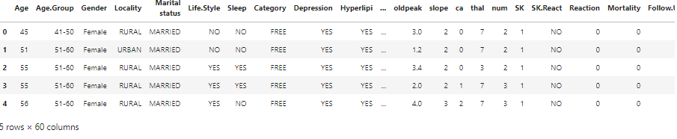
Getting Data
Data source: https://www.kaggle.com/datasets/asgharalikhan/mortality-rate-heart-patient-pakistan-hospital
Notes:
CLICE 1 <In our case, we found a Heart Failure Prediction Dataset obtained from the web address shown on the slide. When each row is one data point, each data point has many properties associated with it.
Since commas separate the properties, we can assume that the CSV data format means comma-separated values.
These are just numbers that represent little to people, but once we read this data, we can try to make sense of it.>

Slide 4
Importing a CSV into Python
# Import pandas library
import pandas as pd
# Read the online file by the URL provided above, and assign it to the variable "df"
url = "https://www.kaggle.com/datasets/asgharalikhan/mortality-rate-heart-patient-pakistan-hospital"
df = pd.read_csv (url)
Notes:
CLICE 1 <In pandas, the read_CSV method can read files from comma-separated columns in the pandas dataframe.>
CLICE 2 <First import pandas, then define the variable using file path and then use the read_ CSV method to import the data. However, read_CSV assumes that the data contains a header.
Our used car data has no column headings. So we need to specify read_CSV for not assigning headers by setting the header to none.>

Slide 5
Question
What is missing from the following code?
1 import pandas as pd
2 # read the online file by the URL provided above, and assign it to variable "df”
3 path=" https://www.kaggle.com/datasets/asgharalikhan/mortality-rate-heart-patient-pakistan-hospital"
4
5 df = read_csv (path, header=None)
read_csv should be pd.read_csv
there is no file path
pandas is imported as pd
Notes:
CLICE 1 <Question>
CLICE 2 <What is missing from the following code?>
1 import pandas as pd
2 # read the online file by the URL provided above, and assign it to variable "df”
3 path="https://www.kaggle.com/datasets/asgharalikhan/mortality-rate-heart-patient-pakistan-hospital"
4
5 df = read_csv (path, header=None)

Slide 6
Importing a CSV without a header
import pandas as pd
url = https://www.kaggle.com/datasets/asgharalikhan/mortality-rate-heart-patient-pakistan-hospital
df = pd.read_csv (url, header = None)
Notes:
CLICE 1 < If no header (title) in raw data file>
import pandas as pd
url = "https://www.kaggle.com/datasets/asgharalikhan/mortality-rate-heart-patient-pakistan-hospital"
df = pd.read_csv (url, header = None)
CLICE 2 <You need to include header = None option to tell Python there is no column name (header) in data.>

Slide 7
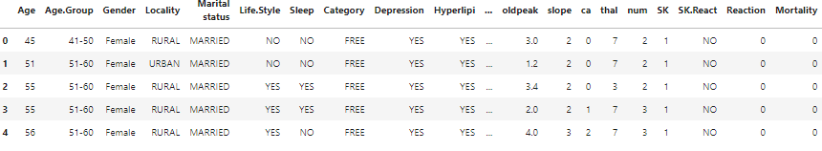
Question
What method was applied on the dataframe df to get the following output?
df.head()
df.tail()
pd.head(df)
Notes:
CLICE 1 <Question>
CLICE 2< What method was applied on the dataframe df to get the following output?>
df.head()
df.tail()
pd.head(df)

Slide 8

Printing the dataframe in Python
df prints the entire dataframe (not recommended for large datasets)
df. head (n) to show the first n rows of the data frame.
df. tail (n) shows the bottom n rows of the data frame.
df. head ()
Header
n=5
Notes:
CLICE 1 <After reading the data set, a good idea would be to look at the data frame to get better intuition and ensure that everything happened as you expected.>
CLICE 2 <Because printing can take up the entire data set too much time and resources to save time, we can use data frame.head to display the first n rows of the dataframe.
Similarly, dataframe.tail shows the bottom end lines of the data frame.>
CLICE 3 <Because printing can take up the entire data set too much time and resources to save time, we can use dataframe.head to display the first n rows of the dataframe.>
CLICE 4 <Similarly, dataframe.tail shows the bottom end lines of the data frame.>
CLICE 5 <The dataset appears to have been read successfully. We can see that pandas automatically sets the column header as a list integer because we set the header value when we read the data.>

Slide 9
Adding headers
• Replace default header (by df.columns = headers)
headers = ["Age", "AgeGroup", "Gender", "Locality", "MaritalStatus", "Lifestyle", "Sleep", "Category", "Depression", "Hyperlipidemia", "Smoking", "Diabetes", "HTN", "Allergies", "BP", "Thrombolysis", "BGR", "CPK", "CK-MB", "ESR", "WBC", "RBC", "Hemoglobin", "PCV", "MCV", "MCH", "MCHC", "PlateletCount", "Neutrophil", "Lymphocyte", "Monocyte", "Eosinophil", "Others", "CO", "Diagnosis", "Hypersensitivity", "CP", "Trestbps", "Chol", "FBS", "Restecg", "Thalach", "Exang", "Oldpeak", "Slope", "CA", "Thal", "Num", "SK", "SKReact", "Reaction", "Mortality", "FollowUp"
df.columns = headers
df.head(10)
Notes:
CLICE 1 < Working with a data frame without meaningful column names is difficult. However, we can assign column names to pandas. In our present case, it turns out that the column names are in a separate file online.>
CLICE 2 <First, we put the column names in a list called headers, then we set df.columns equals
headers to replace the standard integer headers with a list.
If we use the head method presented on the last slide to validate the data set, we see the correct headings inserted at the top of each column.>

Slide 10
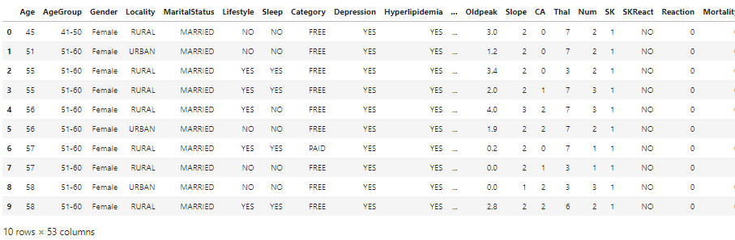
Adding headers
• Replace default header (by df.columns = headers)
Notes:
CLICE 1 <First, we put the column names in a list called headers, then we set df.columns equals
headers to replace the standard integer headers with a list.
If we use the head method presented on the last slide to validate the data set, we see the correct headings inserted at the top of each column.>

Slide 11
Exporting a Pandas dataframe to CSV
• Preserve progress anytime by saving modified dataset using
path=" C: /Windows/.../heart_failure.csv”
df.to_cv (path)
Notes:
CLICE 1 <At some point in time after performing operations on the data frame you can want to export a panda dataframe to a new CSV file. This can be done using the to_CSV method.>
CLICE 2 < To do this, specify the path to the file which contains the name of the file you want to write to.
For example, if you want to save a frame of data df as heart_failure.CSV to your computer, you can use the df.to_CSV syntax.>

Slide 12
Exporting to different formats in Python
CLICE 2 <
>
Data Format | Read | Save
csv | pd.read_csv() | df.to_csv()
json | pd.read json() | df.to_json()
Excel | pd.read_excel() | df.to_excel()
sql | pd.read_sql() | df.to_sql()
Notes:
CLICE 1 <In this course, we will only read and save CSV files. However, pandas also support importing and exporting most types of data files in various dataset formats. Code syntax for reading and keeping other data formats is similar to a task or saving a CSV file.
Each column shows different reading methods and saves files in a different format.>

Slide 13

IBM Developer
Notes:
CLICE 1 <You just saw the steps needed to create a DataFrame, and then export that DataFrame to a CSV file. You may face an opposite scenario in which you must import a CSV into Python. If that’s the case, you can check out this course that explains how to import a CSV file into Python using Pandas.
You may also want to check the Pandas Documentation for further information about using ‘to_csv’.>

